Slide 1

Flight: price prediction
10th Aug,2022
Internship-27
Presented by:
Someshwar Dipak

Slide 2
Acknowledgement
Data Science with ML
SME – Sapna Verma
Flip Robo Technology

Slide 3
Why Flight Price Prediction Need:
Anyone who has booked a flight ticket knows how unexpectedly the prices vary.
The cheapest available ticket on a given flight gets more and less expensive over time.
This usually happens as an attempt to maximize revenue based on –
1. Time of purchase patterns (making sure last-minute purchases are expensive)
2. Keeping the flight as full as they want it (raising prices on a flight which is filling up in order to reduce sales and hold back inventory for those expensive last-minute expensive purchases)

Slide 4
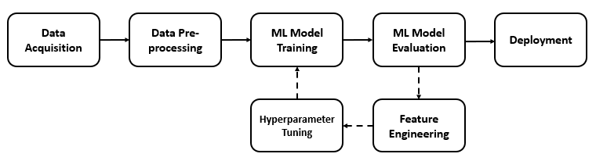
Flight: PRICE PREDICTION Diagram:

Slide 5
Visualization of Flight Price

Slide 6
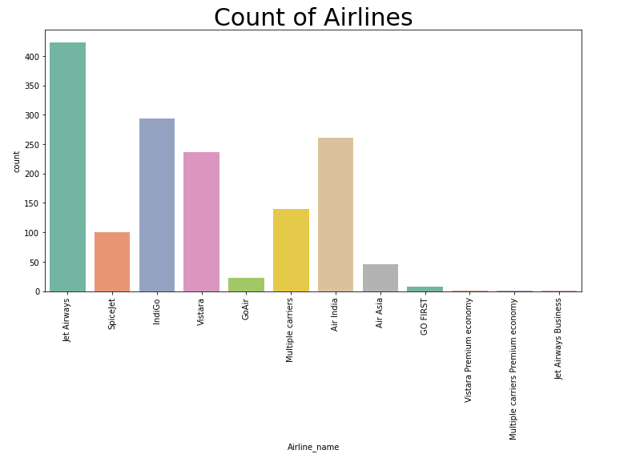
Graphs:
In this graph count of jet airways, indigo and air india airline is higher then others. Travelers are likes this airlines for travelling.

Slide 7
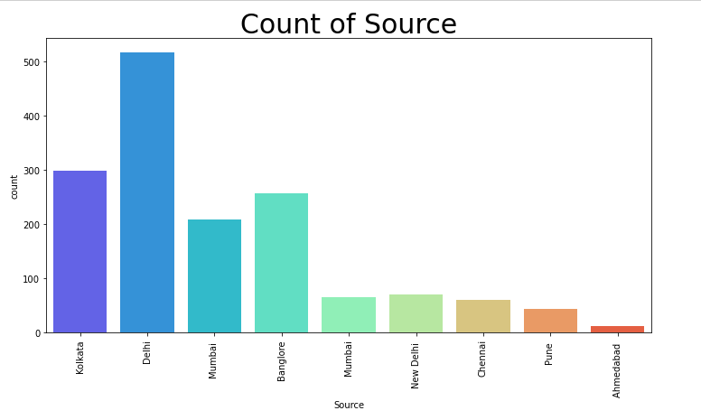
Graphs:
In this graph count of Delhi source is high then other city. Kolkata and Bangalore has average count. Delhi is capital of india and it's center city of india so obvious source of this city is high.

Slide 8
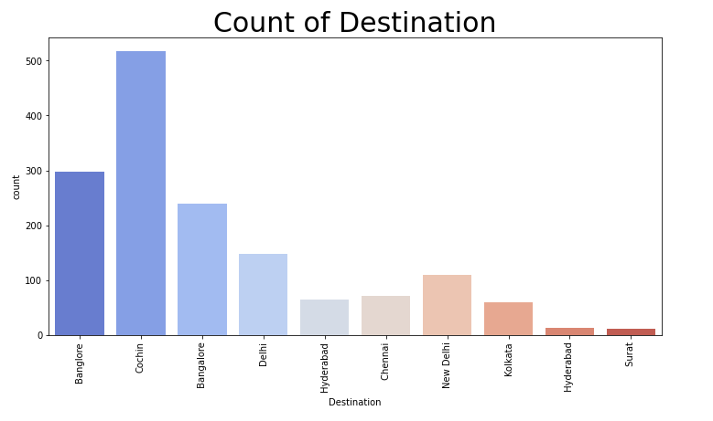
Graphs:
In this graph count of Cochin and Bangalore city destination is high then other city. All It sector related and digital things related Bangalore is first choice.

Slide 9
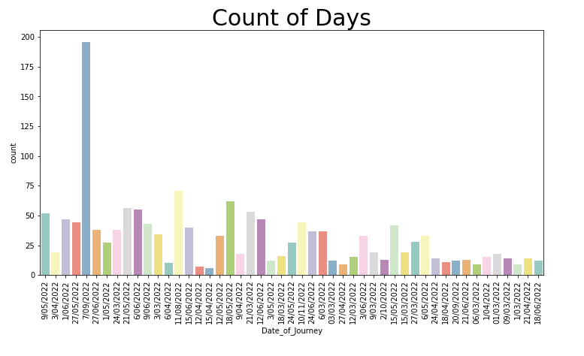
Graphs:
In this graph count of may and june month days are very much because of vacation time.

Slide 10
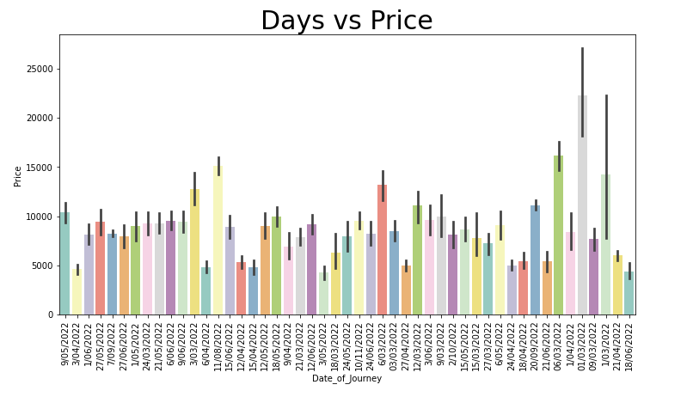
Graphs:
In this graph count of april month ticket price is lower then other months. May be It's best time to buy tickets.

Slide 11
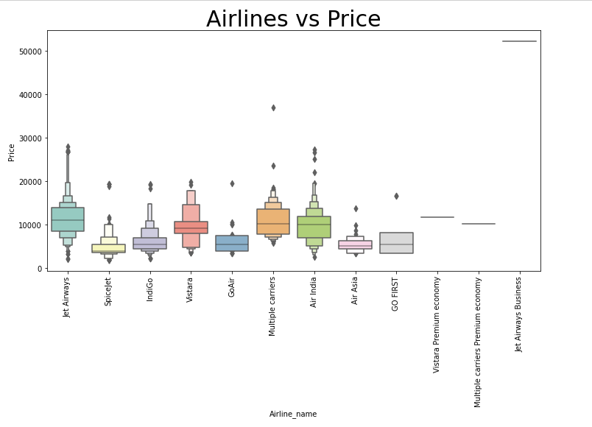
Graphs:
In this graph count of jet airways and multiple carriers airline has higher price than others.

Slide 12
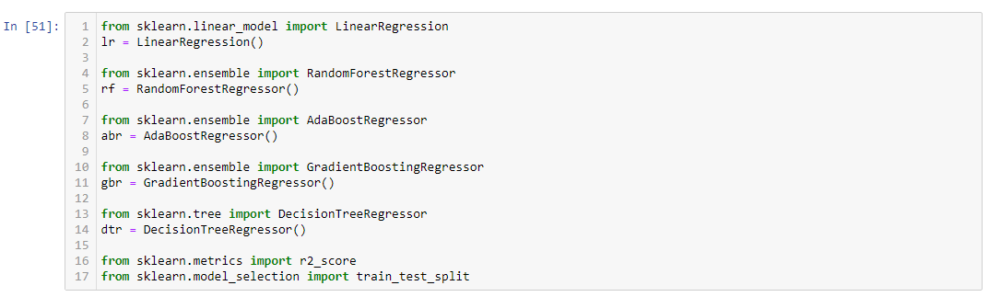
Model Building, Model Evaluation and Selecting the best model

Slide 13
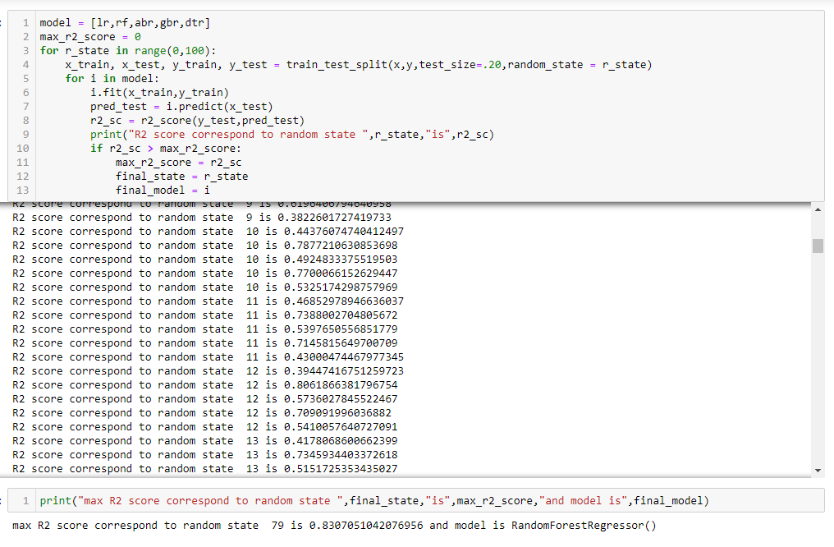
Model Building, Model Evaluation and Selecting the best model

Slide 14
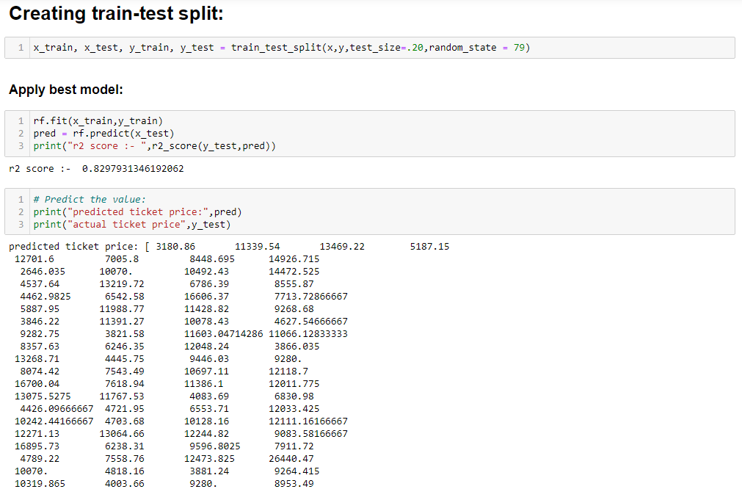
Model Building, Model Evaluation and Selecting the best model

Slide 15
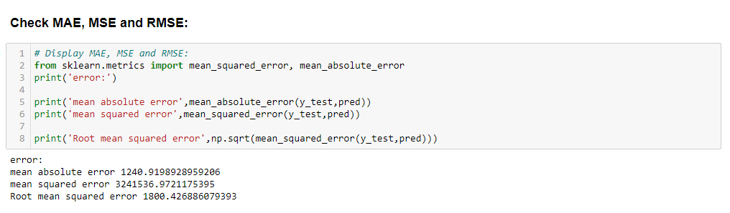
Check mae, mse and rmse:

Slide 16
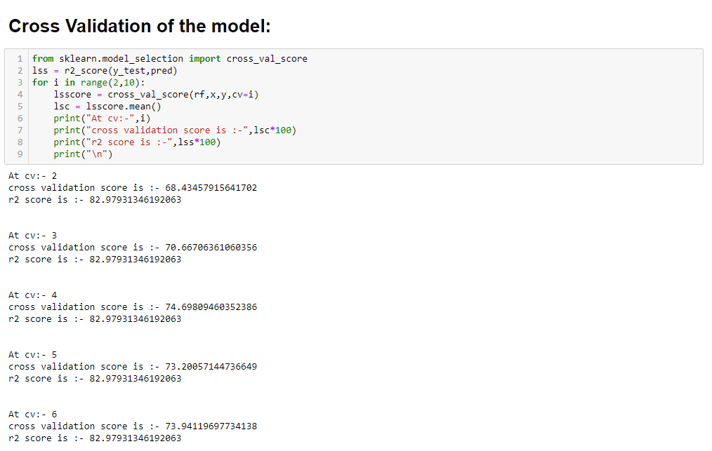
Cross-Validation:

Slide 17
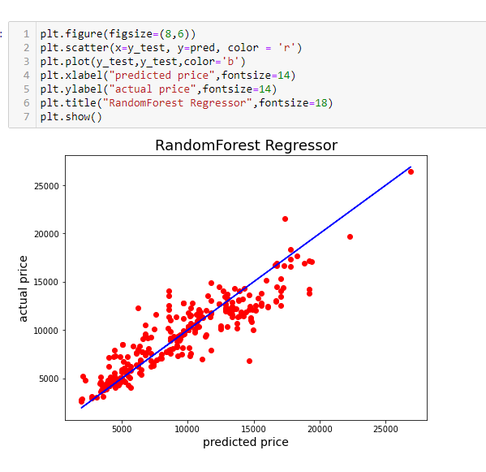
Actual price vs Predicted price:

Slide 18
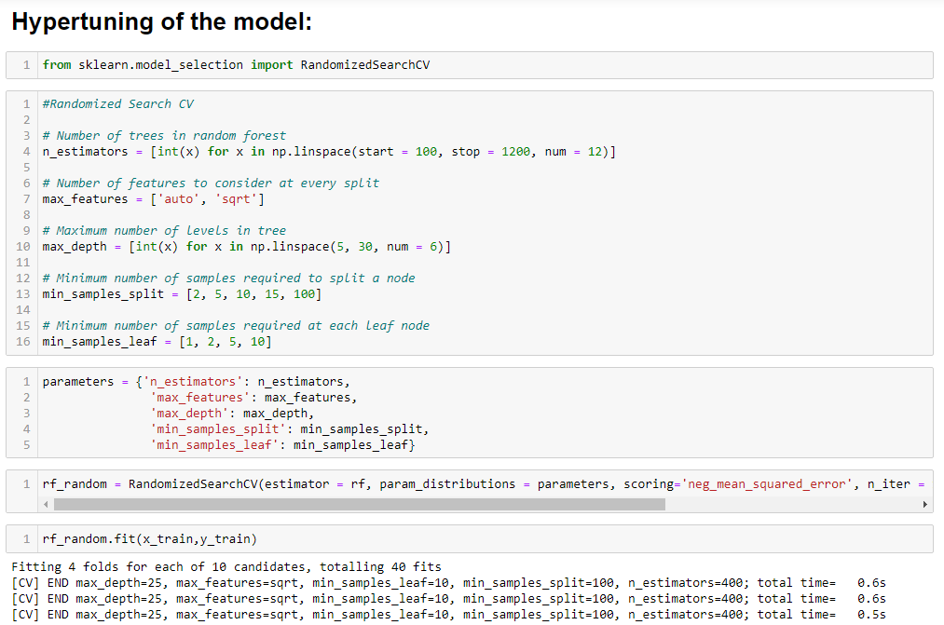
Hypertuning of the model:

Slide 19
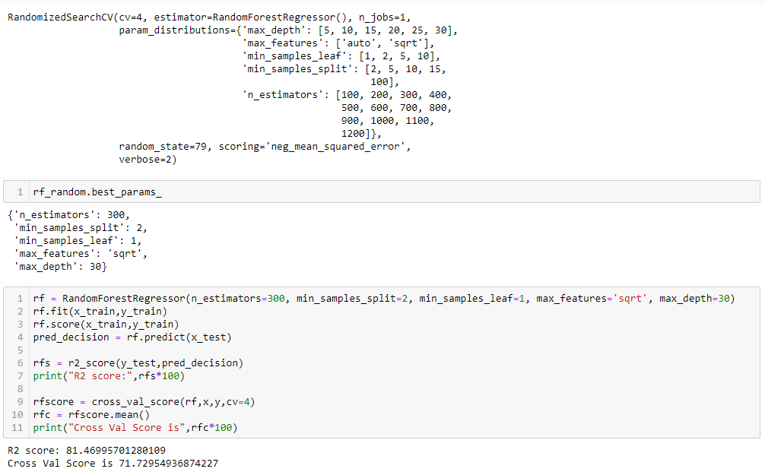
Hypertuning of the model:

Slide 20
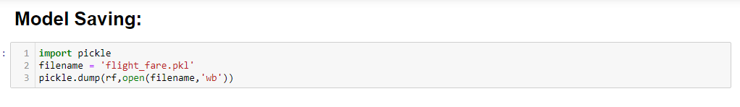
Model Saving:

Slide 21
Conclusion:
This Kernel investigates different models for flight price prediction.
Different types of Machine Learning methods including LinearRegression, RandomForestRegressor, AdaBoostRegressor, GradientBoostingRegressor and DecisionTreeRegressor in machine learning are compared and analysed for optimal solutions.
Even though all of those methods achieved desirable results, different models have their own pros and cons.
The RandomForestRegressor is probably the best one and has been selected for this problem.
Finally, the RandomForestRegressor is the best choice when parameterization is the top priority.

